Slide 1

Team 1 Presentation
By Thomas, Kavell, Peter, and Billy

Slide 2
Client Requirements:
To complete this project we needed to know our clients requirements
This included:
An initial discussion with our client
A design survey
A functionality survey
LSEPI analysis of the application

Slide 3



Design Survey
We conducted a design survey, asking how the application should look:
What colours should be used? -> Turquoise and white
Does the company have a logo? ->
How should text be presented? -> CLEAR AND EASY READ
How user friendly should it be? -> Easy to learn, easy to explain
Should it have unified look? -> Yes

Slide 4






Functionality Survey
We asked our client what functions the program would require such as:
Viewing the payslip
Approving and assigning time off
Creating a schedule and viewing it as a timetable.
Employees should not be able to do things above their access level
Clearing data of past employees in accordance with the data protection act.
The program should function a login screen.

Slide 5

Initial Client Discussion
We discussed several key points with the client:
What they wanted from us
The functionality it would require
We used this to form furthermore in-depth discussions:
Such as functionality and design for the program
I need…

Slide 6
Flow Charts
Using this client specification, we created flowcharts:
ADD FLOW CHART EXAMPLES HERE

Slide 7
Pseudocode
Using these flowcharts, we developed pseudocode:
ADD PSEUDOCODE EXAMPLES HERE

Slide 8
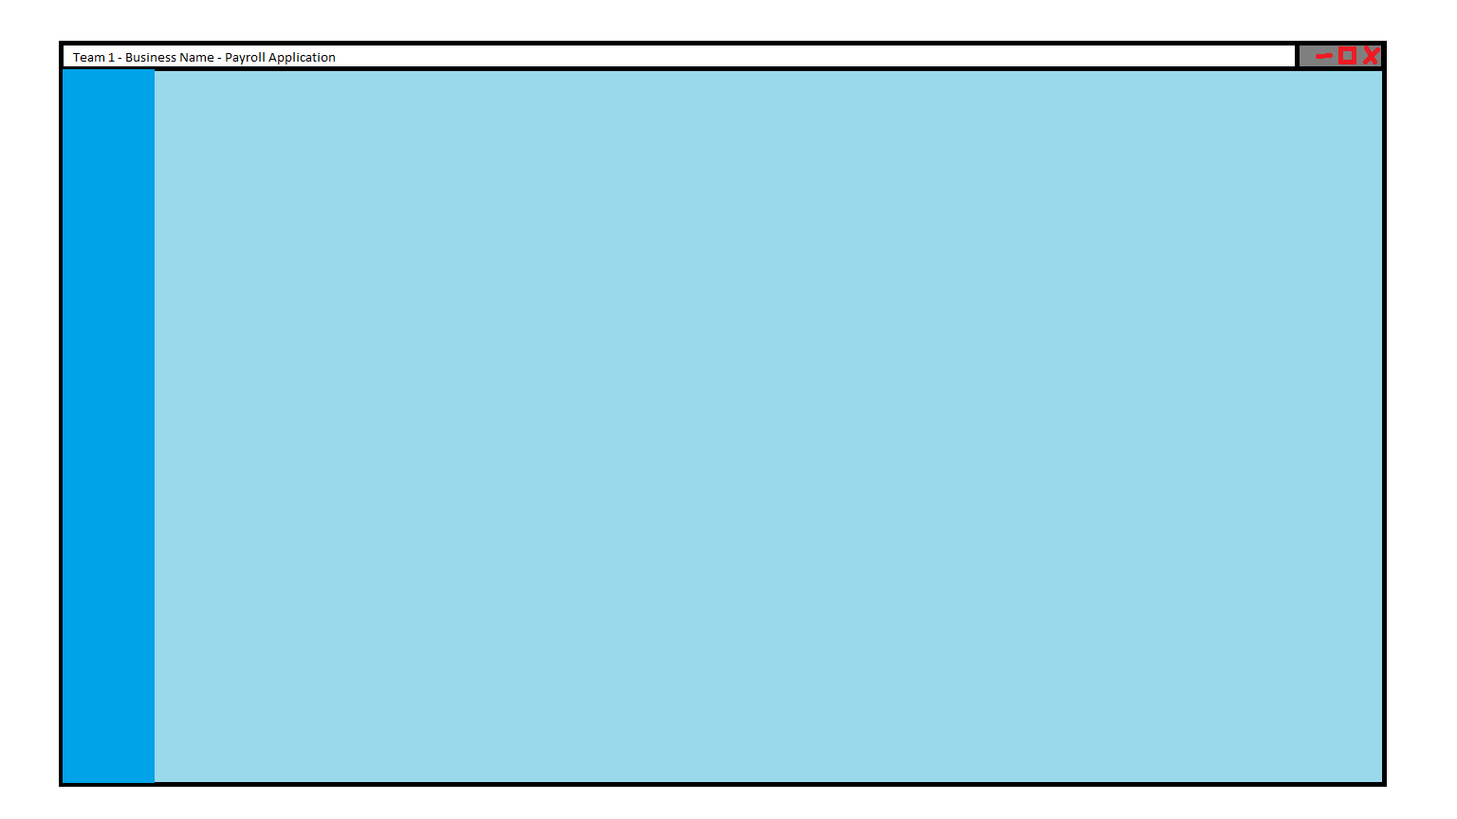
GUI Design
Considering the client’s specification, flowcharts, and pseudocode we created GUI templates to help in code development.
Here is a generic template used in all our GUI designs
It features appropriate colours as specified in the client specification.

Slide 9
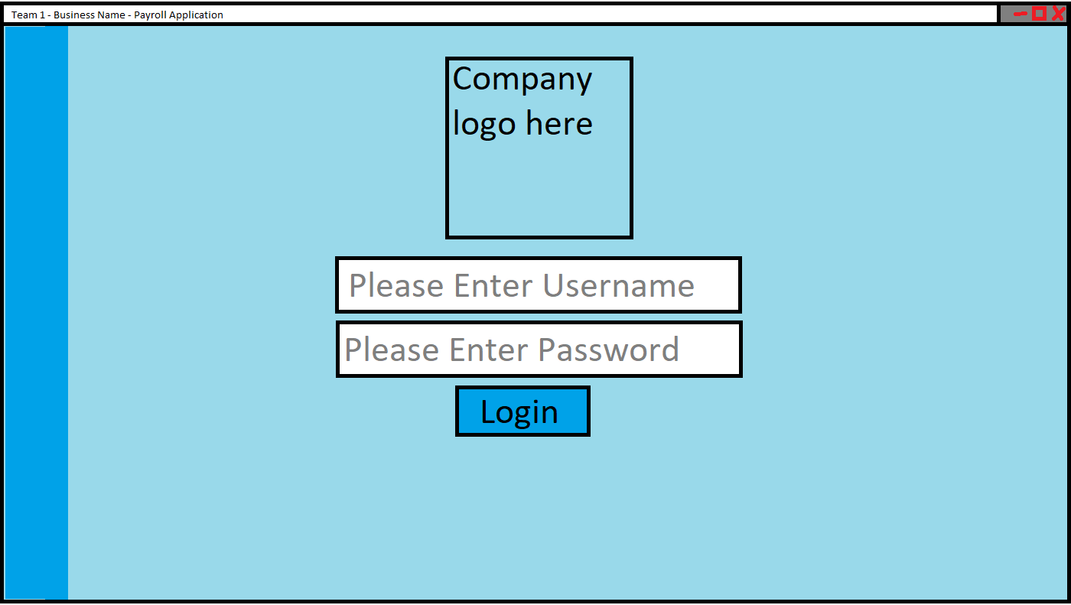
GUI Design - Login
This is the login page we produced:
It leaves room for the logo as requested by the client.
It uses clear lettering so people with poor vision can use it.

Slide 10
GUI Design – Main pages
We chose this design as it gives the employees access to all of the relevant image on a single screen.
We use two variants of the same screen as both admins and regular staff to do not need access to them same information.
E.G. employees don’t need to see other employee’s pay slips.
IMAGES CORROPTED ILL FIX IT LATER

Slide 11

LSEPI
We had to follow and consider LSEPI while designing the application
Legal
Social
Ethical
Professional

Slide 12

Legal issues
Data protection act
Must adhere to its principles such as accurate data.
Extra protection around personal details such as religion.
Maintain peoples rights, such as to have their data erased.
Copyright protection act
Must not include copyrighted material
Computer misuse act
Must have safeguards to prevent misuse

Slide 13
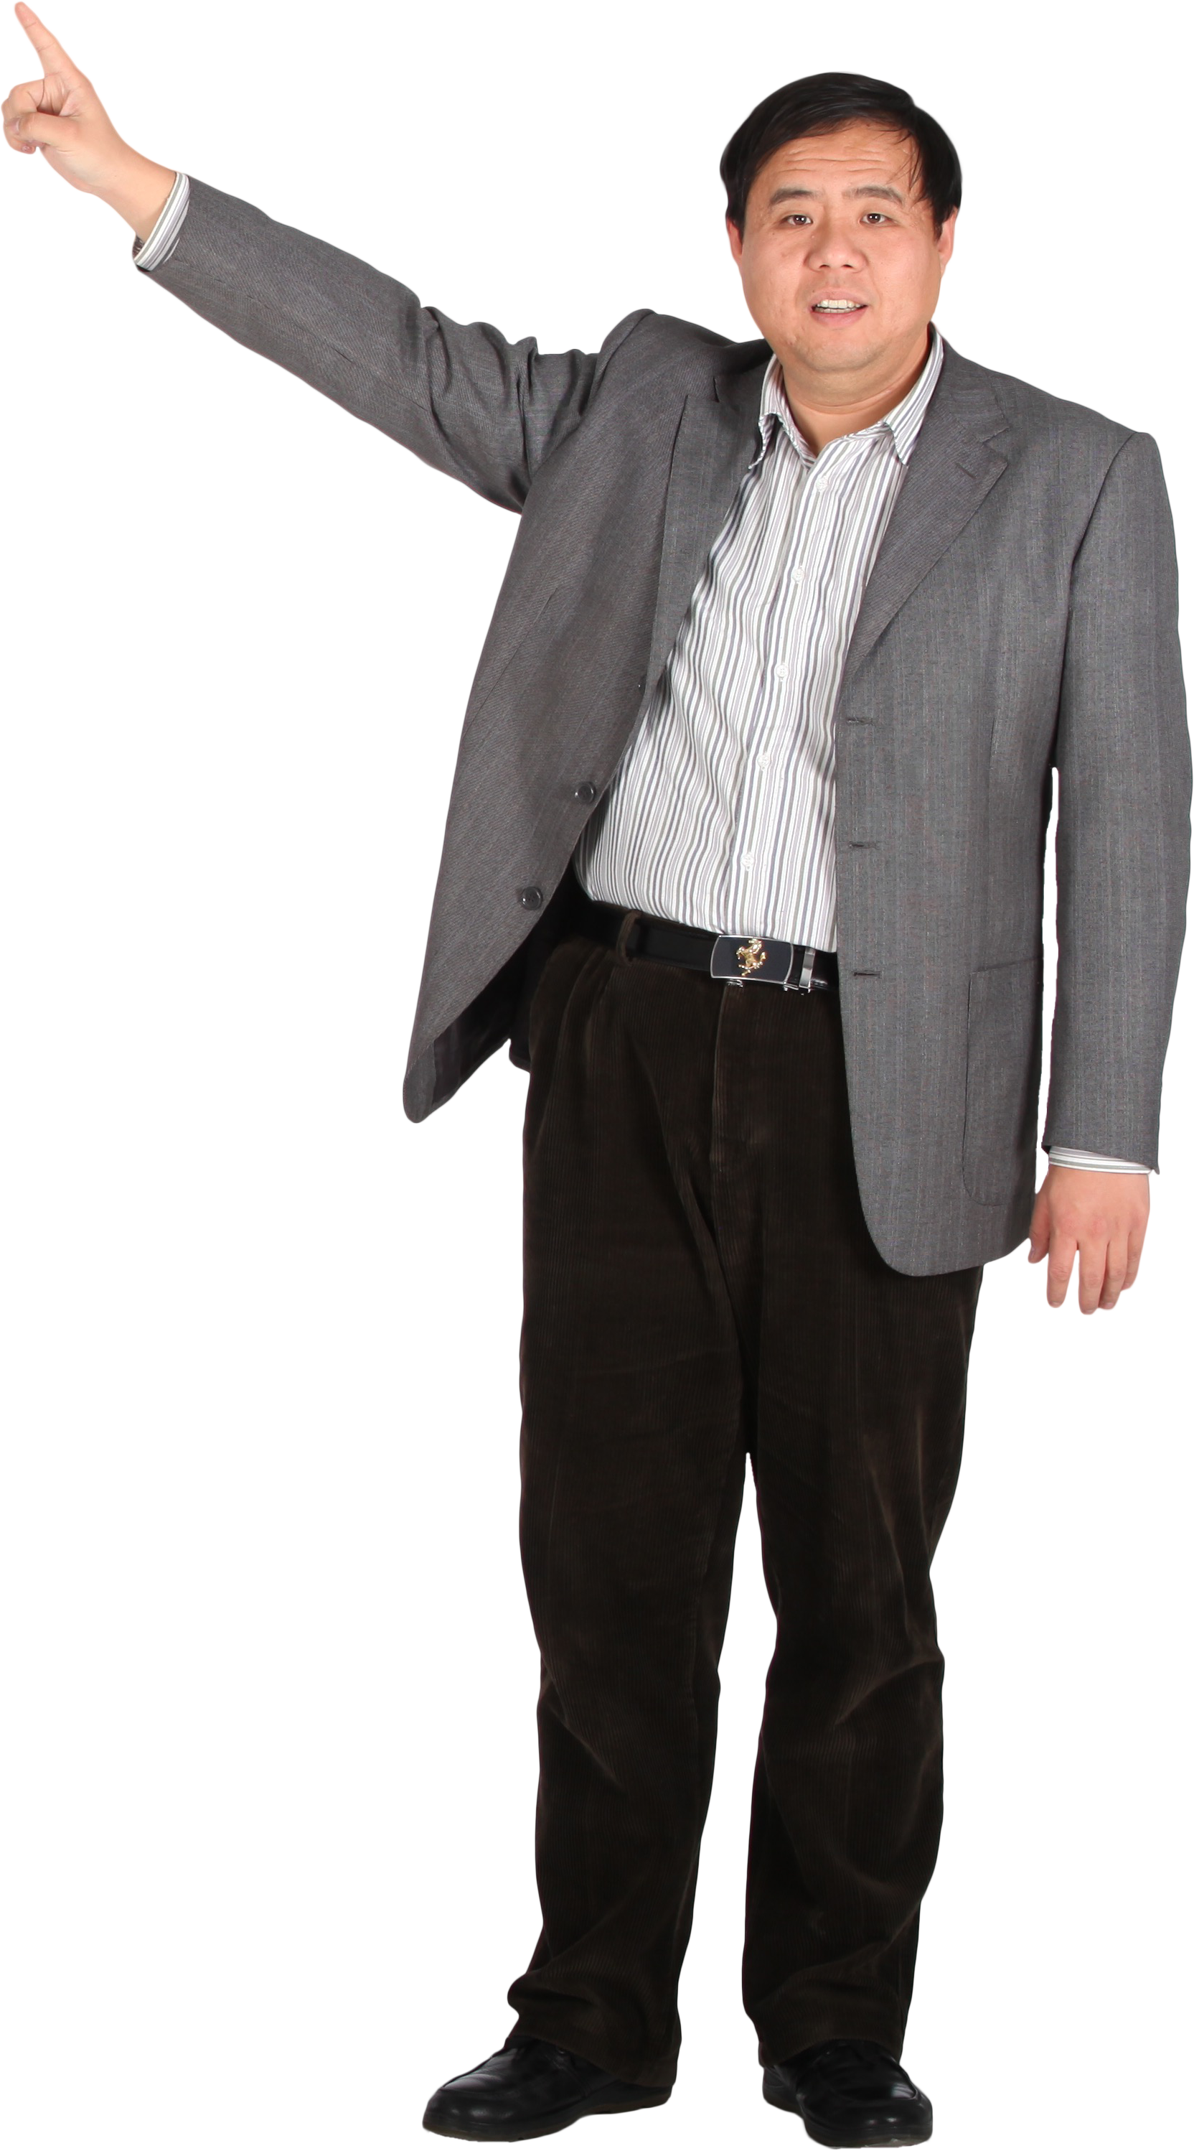
Social Issues
Holidays and sick time:
The database should never deny an employee from reaching time off.
They should always have access to their minimum holiday requirements.
Right to privacy:
Employees shouldn’t have their personal privacy leaked to managers who shouldn’t have access to said information.

Slide 14
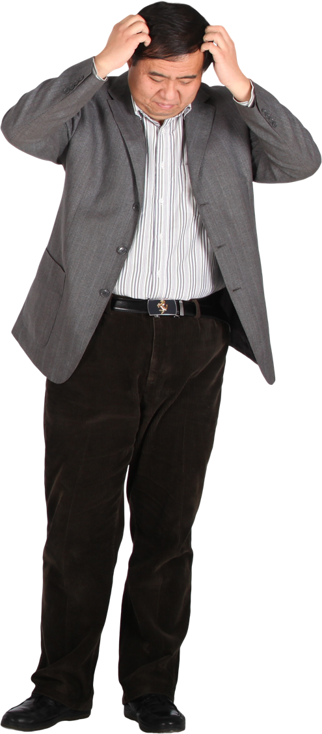
Ethical Issues
Employees have a right to how their data is handled:
This means their data should be kept securely.
It should be kept accurately.
And it must be kept confidential.

Slide 15
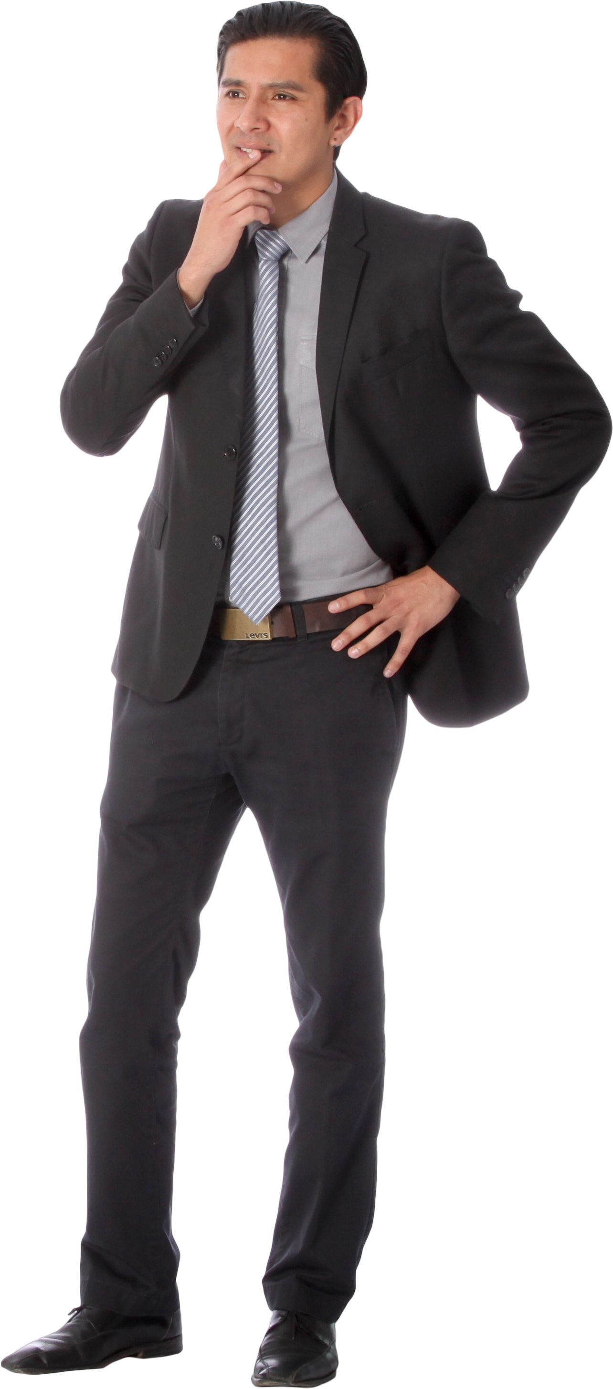
Professionalism issues
Quality:
Our work should be up to the level of quality as our knowledge and skills would allow.
We should understand the code we right so that it makes sense and functions as intended.
Client Relationship:
We should continue to work with our client and ask for advice and their opinions on the project as it progresses.
Attitude:
We should maintain a professional demeanor while working on the project or when using official communication tools involved with the project.

Slide 16
Gant chart

Slide 17
Slack

Slide 18
GIT HUB

Slide 19
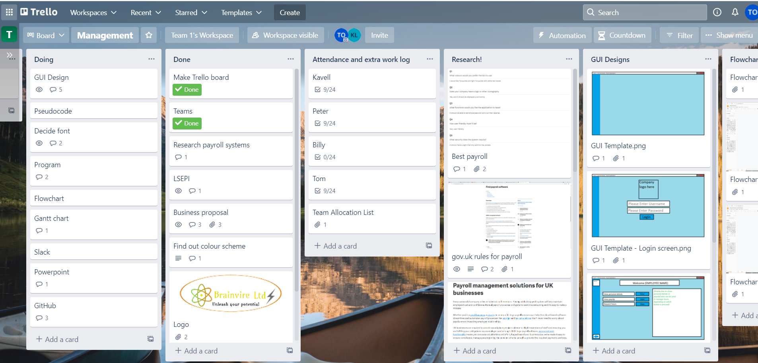
TRELLO
To help organize ourselves we created a Trello board to keep up to date on tasks.
Helps us to keep up on deadlines and not fall behind.
Helps to assign a workload.
Is updated as we complete tasks
Here is an example of the Trello board:

Slide 20
PORTFOLIO

Slide 21
CODE

